Slide 1

Hospital Management System
Name: md Yearul islam
Round: 47
Batch: WDPF
Id: 1263640

Slide 2
About Project
The purpose of the project entitled as “HOSPITAL MANAGEMENT SYSTEM” is to computerize the Front Office Management of Hospital to develop software which is user friendly, simple, fast, and cost – effective. It deals with the collection of patient's information, diagnosis details, etc.
The main objective of the Hospital Management System is to manage the details of Hospital, Doctor, Employee, Test, Medicine. It manages all the information about Hospital, Patient, Medicine, Hospital. The project is totally built at administrative end and thus only the administrator is guaranteed the access.
Hospital management allows the structured functioning of healthcare, makes delivery of various services smooth and easy. For big hospitals which offers wide array of services, it allows: To Track Financial Better by planning funds flow, better investments and expense controlling

Slide 3
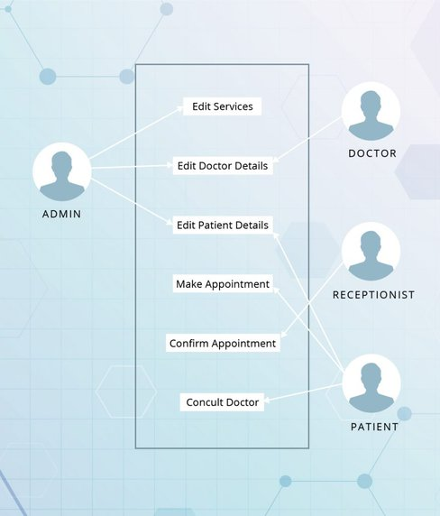
Features of Hospital Management System
Hospital Management System or HMS Software is mainly a system that can help to maintain any hospital activities properly and easily. Moreover, the hospital management system can be used as clinical software. Also, it helps to keep records and monitor the activities of any hospital. The hospital management system automates the clinic’s work and optimizes the utilization of resources instead of only the storage and presentation of the information. It balances the occupancy rates and calculates the number of required employees

Slide 4
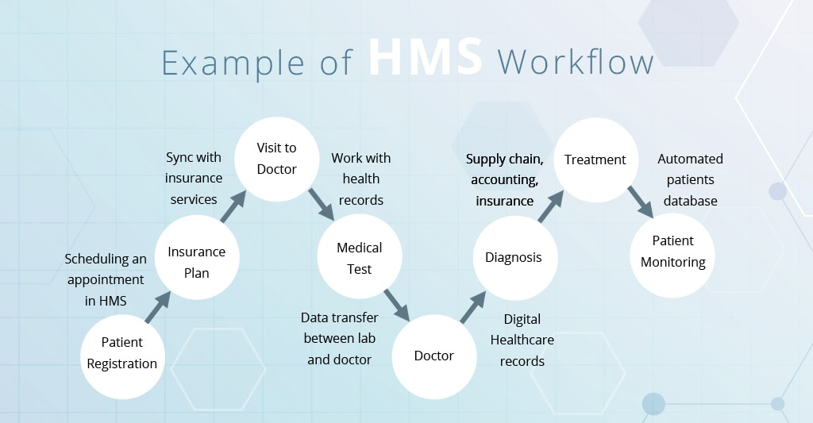
Work Flow

Slide 5
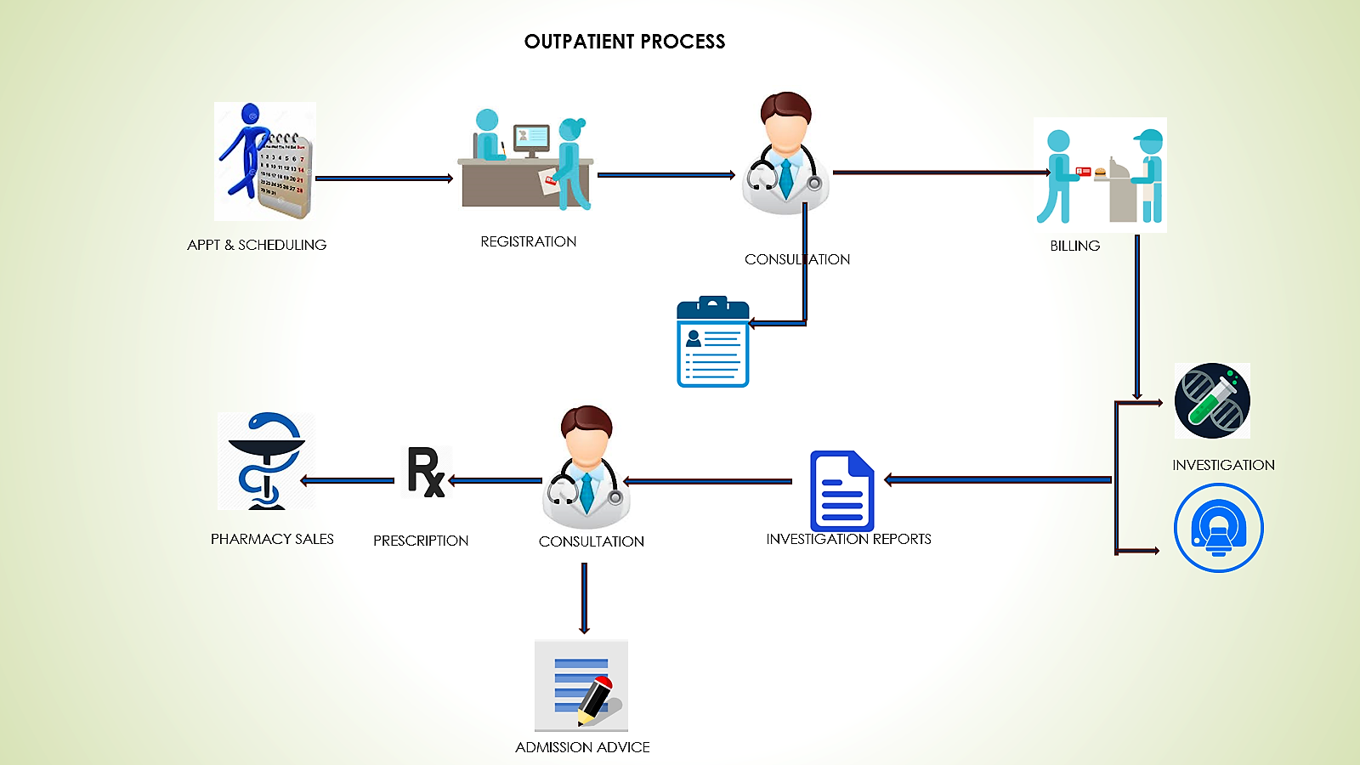
Work Flow

Slide 6
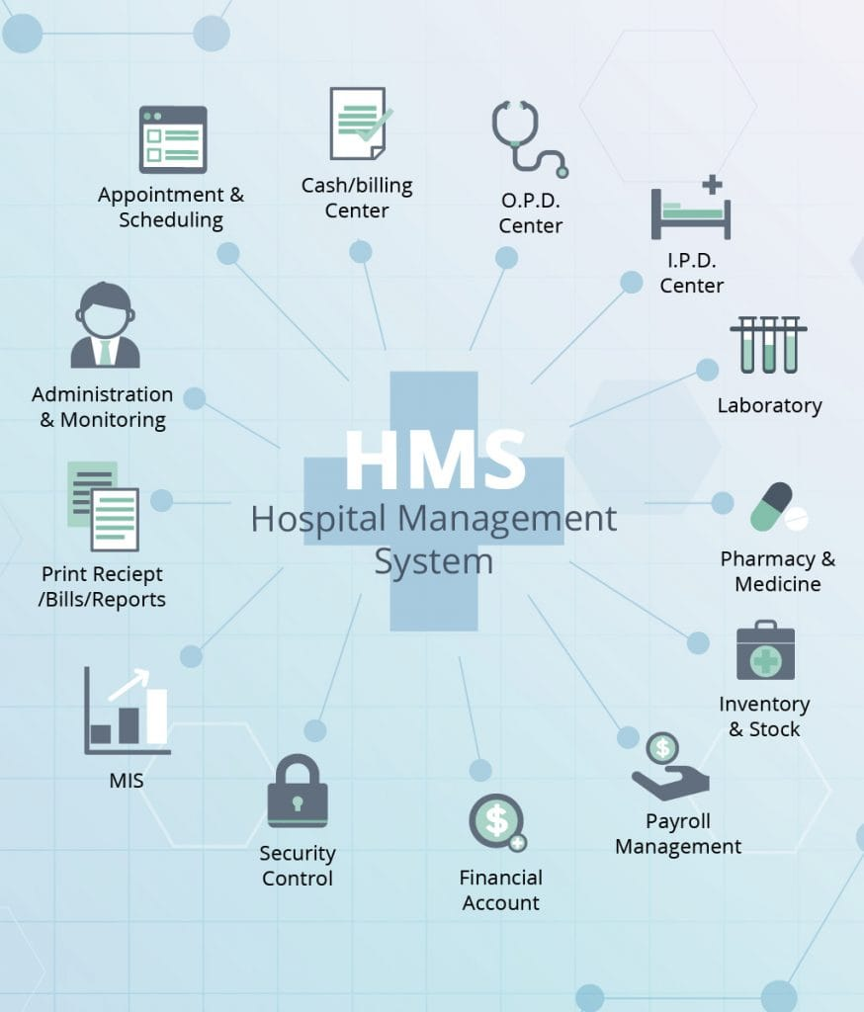
COMPONENTS OF HOSPITAL INFORMATION SYSTEM

Slide 7
Appointment Management
Billing Management
For hospitals having their own site, appointment widgets will be integrated onto the site. Patients visiting the hospital’s website can book online appointments with ease
Integrated Billing with treatments, Lab and Radiology. Alerts will be sent on Discount Authorization. Automatic due capture, Option to bill before and after consultation.
Prescription Management
Discharge Summary
Manage commonly and recently used medicines. Option to show medicines available in the pharmacy. SMS prescriptions to Patients.
Template based Discharge Summary. ICD10 integration. Option to prevent discharge summary till IP bill is closed.

Slide 8
Operation Theatre Management:
Pharmacy Management
Automatic notification can be sent to customers on test results. Lab notifications like email, SMS of the test reports sent from the Automated Lab notification module.
Comprehensive Pharmacy Management handles stock, Prescription Integration, Ward Request, Stock Management, Stock Moment and intelligent reports.
Lab Management
Reporting
Comprehensive Lab Management handles complete order management, Custom Reports, Smart Notifications, Credit Settlement, detailed MIS Reports, Analytics and App for Phlebotomist
Report management part stores the already processed detailed information. This module helps management collect, analyze and view the performance data in a comprehensive format. The business intelligence subsystem helps define problematic aspects and successfully eliminate them to keep the business profitability as well the high customer satisfaction level.

Slide 9
MODULES
The entire project mainly consists of 7 modules,
which are:
Admin module
User module (patient)
Doctor module
Nurse module
Pharmacist module
Laboratories module
Accountant module

Slide 10
Admin module
manage department of hospitals, user, doctor, nurse, pharmacist, laboratories accounts.
watch appointment of doctors
watch transaction reports of patient payment
Bed, ward, cabin status
watch blood bank report
watch medicine status of hospital stock
watch operation report
watch birth report
watch diagnosis report
watch death report

Slide 11
user module(patient)
View appointment list and status with doctors
View prescription details
View medication from doctor
View doctor list
View blood bank status
View operation history
View admit history. like bed, ward ICU etc.
Manage own profile

Slide 12
Doctor module
Manage patient. account opening and updating
Create, manage appointment with patient
Create prescription for patient
Provide medication for patients
Issue for operation of patients and creates operation report
Manage own profile

Slide 13
Nurse module
Manage patient. account opening and updating
Allot bed, ward, cabin for patients
Provide medication according to patient prescription
Manage blood bank and update status
Keep record of patient operation, baby born and death of patient
Manage own profile

Slide 14
Pharmacist module
Maintain medicine
Keep records of hospitals stock medicines and status
Manage medicine categories
Watch prescription of patient
Provide medication to prescriptions

Slide 15
Laboratories module
Watch prescription list
Upload diagnostic report
Preview of report files. like x-ray images, CT scan, MRI reports.
Manage own profile
Accountant module
Create invoice for payment
Order invoice to patient
Take cash payment
Watch payment history of patients
Manage own profile

Slide 16
Technologies:
PHP:
The main bulk of the website was written in PHP as it offers good performance and is easy to integrate into most servers. PHP code is also clean and easy to understand with lots of resources available.
JavaScript:
JavaScript was used to add some dynamic elements on the front end as well as any client side validation that needs to be done. JavaScript libraries such as jQuery were used where needed for design and accessibility features.

Slide 17
Ajax:
Ajax was used to update portions of the website dynamically. It was also used to add pagination to a user’s news feed to improve load times and responsiveness.
MySQL:
An online MySQL database was used to store all data pertaining to the project.
Bootstrap:
Where possible the website used the Twitter Bootstrap framework to minimise HTML and help the site respond to changing screen sizes.

Slide 18
Laravel 8:
Laravel 8 is a PHP framework that was used to streamline some of the more common website tasks such as sessions and cookies. It also has a lot of helper functions to manage database calls for saving, updating or displaying data.
Apache Server:
A local Apache web server was used to run the PHP code during the development of the website.

Slide 19
Hardware & Software Requirements
● Desktop PC or Laptop .
● Apache Server.
● Sublime Text / Visual Studio Code.
● GitHub.
● MySQL.
● XAMP.
● Google Chrome / Mojela Fire Fox or any Browser.

Slide 20
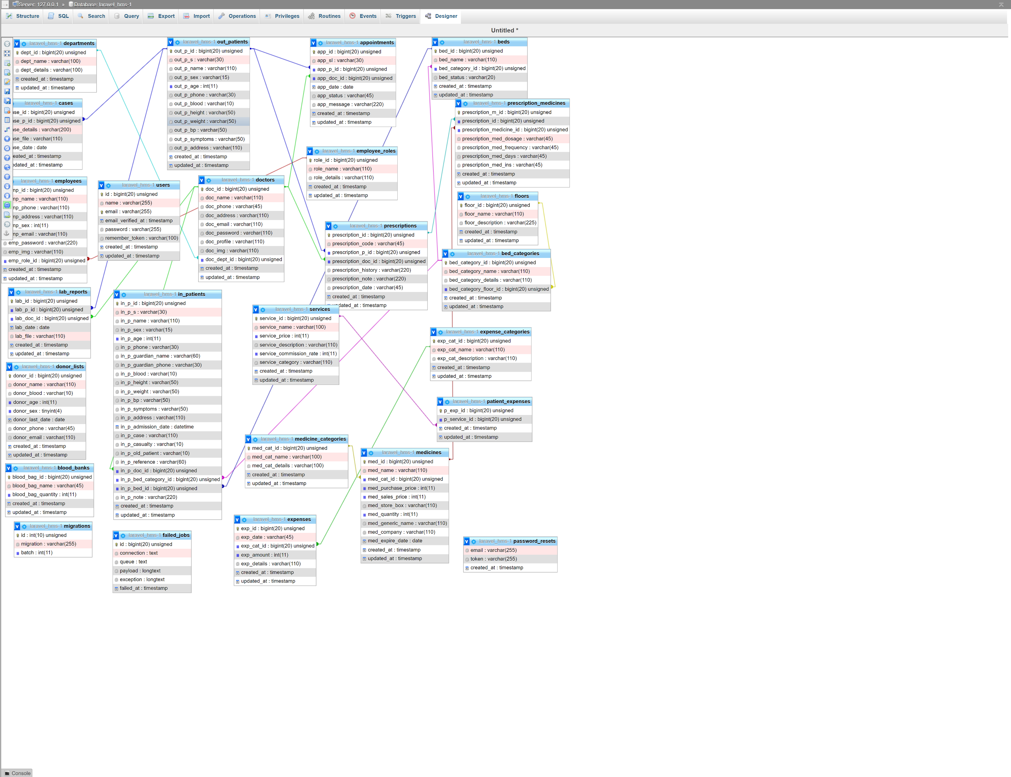
Database Design:

Slide 21
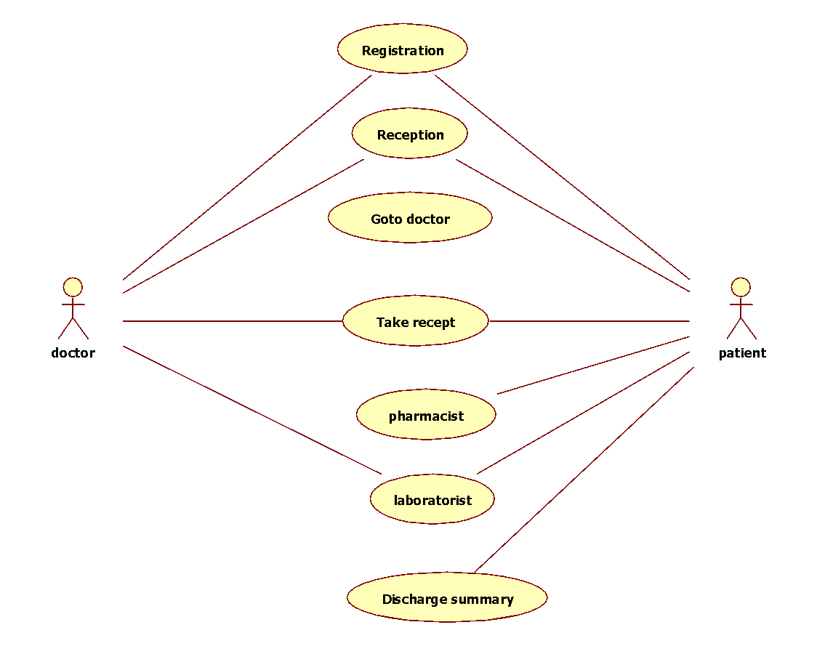
Unified Modeling Language (UML)
case diagram:

Slide 22
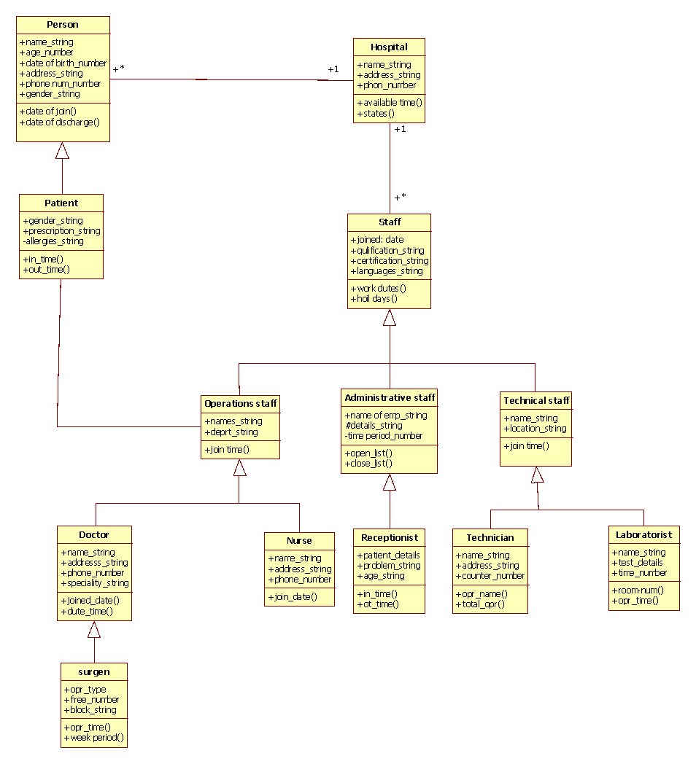
Class Diagram
A Class is a category or group of things that has similar attributes and common behavior. A Rectangle is the icon that represents the class it is divided into three areas. The upper most area contains the name, the middle; area contains the attributes and the lowest areas show the operations. Class diagrams provides the representation that developers work from. Class diagrams help on the analysis side, too.

Slide 23
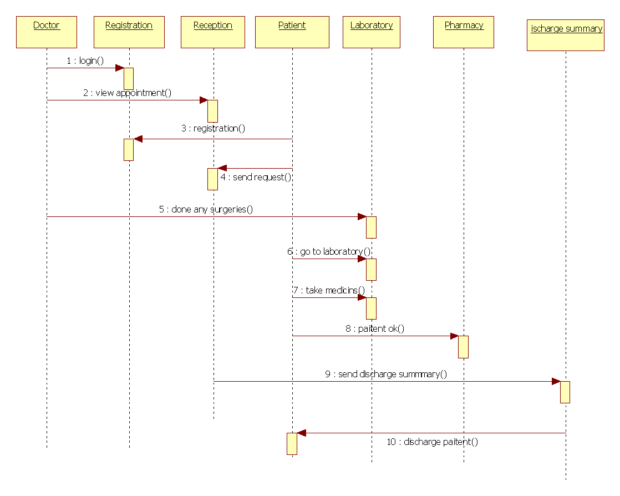
Sequence diagram
A Sequence Diagram is an interaction diagram that emphasis the time ordering of messages; a collaboration diagram is an interaction diagram that emphasizes the structural organization of the objects that send and receive messages. Sequence diagrams and collaboration diagrams are isomorphic, meaning that you can take one and transform it into the other

Slide 24
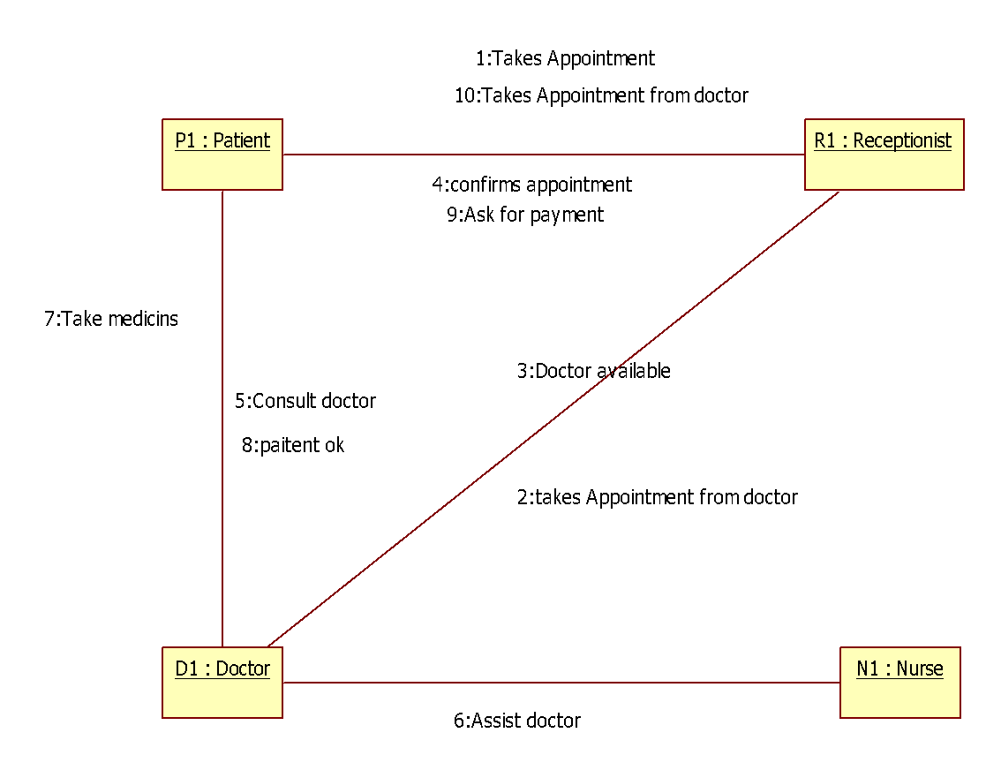
Collaboration diagram
A Collaboration Diagram also called a communication diagram or interaction diagram, is an illustration of the relationships and interactions among software objects. The concept is more than a decade old although it has been refined as modeling paradigms have evolved.

Slide 25
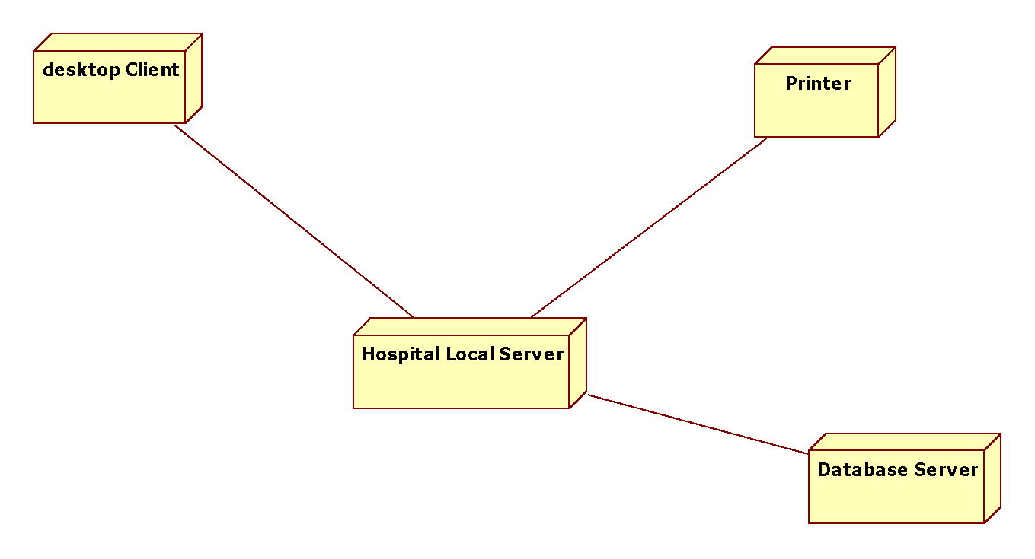
Deployment diagram

Slide 26
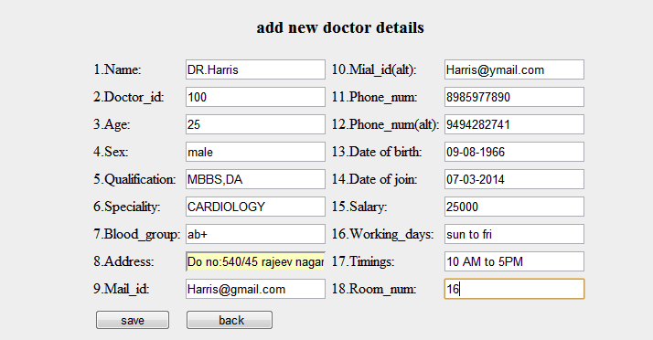
ADDING NEW DOCTOR FORM

Slide 27
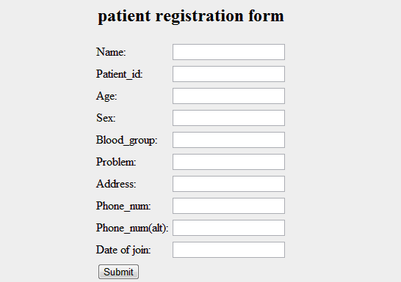
Patient registration form:

Slide 28
Thank You

